Slide 1
Build Angular SPAs with the Microsoft Graph

Slide 2

Register Azure AD Applications
Microsoft Application Registration Portal
Configure credentials
Select the type of application
Configure permissions

Slide 3
Azure AD Portal
Register applications at https://portal.azure.com/ for users to login to the custom application using their Azure AD or Microsoft accounts
Create web applications, native applications (including mobile) and
Obtain application ID and secret for use in the custom code solution
Define scopes / permissions ahead of time and
Supports dynamic consent – define scopes / permissions at runtime

Slide 4
Creating an Azure AD Portal

Slide 5
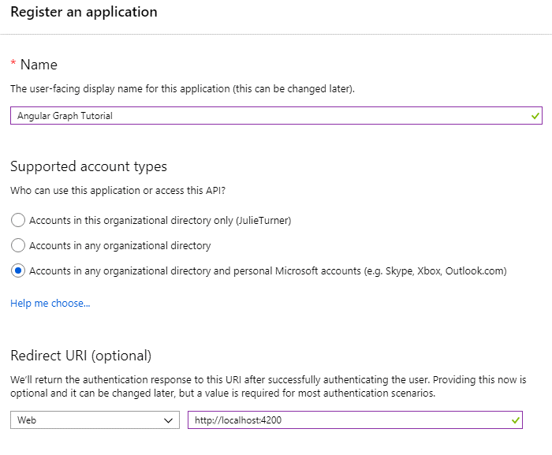
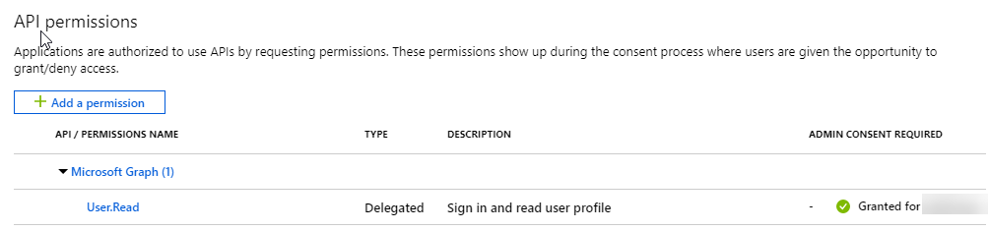
Application registration
Create a new application
Create a new application in the Application Registration Portal. A unique identifier is created for your app.
Add permissions (Optional)
Add permissions that your application will need if your admin will consent for all users.

Slide 6
Demo

Slide 7
Thank you.

